Slide 1
LESSON -1

Slide 2
Basics of Statistics
Definition: Science of collection, presentation, analysis, and reasonable interpretation of data.
Statistics presents a rigorous scientific method for gaining insight into data. For example, suppose we measure the weight of 100 patients in a study. With so many measurements, simply looking at the data fails to provide an informative account. However statistics can give an instant overall picture of data based on graphical presentation or numerical summarization irrespective to the number of data points. Besides data summarization, another important task of statistics is to make inference and predict relations of variables.

Slide 3
Types of Statistics
Descriptive Statistics – Methods of organizing, summarizing, and presenting data in an informative way
Inferential Statistics – The methods used to determine something about a population on the basis of a sample
  Population –The entire set of individuals or objects of interest or the measurements obtained from all individuals or objects of interest
  Sample – A portion, or part, of the population of interest

Slide 4
Descriptive Statistics
Collect data
  e.g., Survey..
Present data
  e.g., Tables and graphs..
Summarize data
  e.g., Sample mean etc…

Slide 5
Inferential Statistics
Estimation
  e.g., Estimate the population mean weight using the sample mean weight
Hypothesis testing
  e.g., Test the claim that the population mean weight is 70 kg
  Inference is the process of drawing conclusions or making
  decisions about a population based on sample results

Slide 6
Statistical Description of Data
Statistics describes a numeric set of data by its
    Center
    Variability
    Shape
Statistics describes a categorical set of data by
    Frequency, percentage or proportion of each category

Slide 7
Statistical data
The collection of data that are relevant to the problem being studied is commonly the most difficult, expensive, and time-consuming part of the entire research project.
Statistical data are usually obtained by counting or measuring items.
  Primary data are collected specifically for the analysis desired
  Secondary data have already been compiled and are available for statistical analysis
A variable is an item of interest that can take on many different numerical values.
A constant has a fixed numerical value.

Slide 8
Data
Statistical data are usually obtained by counting or measuring items. Most data can be put into the following categories:
Qualitative - data are measurements that each fall into one of several categories. (hair color, ethnic groups and other attributes of the population)
Quantitative - data are observations that are measured on a numerical scale (distance traveled to college, number of children in a family, etc.)

Slide 9
Qualitative data
Qualitative data are generally described by words or
letters. They are not as widely used as quantitative data
because many numerical techniques do not apply to the
qualitative data. For example, it does not make sense to
find an average hair color or blood type.
Qualitative data can be separated into two subgroups:
dichotomic (if it takes the form of a word with two options (gender - male or female)
polynomic (if it takes the form of a word with more than two options (education - primary school, secondary school and university).

Slide 10
Quantitative data
Quantitative data are always numbers and are the
result of counting or measuring attributes of a population.
Quantitative data can be separated into two
subgroups:
discrete (if it is the result of counting (the number of students of a given ethnic group in a class, the number of books on a shelf, ...)
continuous (if it is the result of measuring (distance traveled, weight of luggage, …)

Slide 11
Frequency Distribution
Consider a data set of 26 children of ages 1-6 years. Then the frequency distribution of variable ‘age’ can be tabulated as follows:
Frequency Distribution of Age
Age | 1 | 2 | 3 | 4 | 5 | 6
Frequency | 5 | 3 | 7 | 5 | 4 | 2
Grouped Frequency Distribution of Age:
Age Group | 1-2 | 3-4 | 5-6
Frequency | 8 | 12 | 6

Slide 12
Frequency Distribution
It is a statistical table shows arrangement of data according to magnitude, size etc. Also called a group data as the data is presented in the form of groups.
Suppose marks of 25 students:
38 52 55 43 46 46 51 43 40 43 42 46
43 42 29 36 40 52 51 42 31 32 39
The above is a raw data, can be arranged in the form of array in ascending order…
After having data in array of ascending order, gives information about min and max values (marks) called range..

Slide 13
Frequency Distribution
Range= max value – min value
= 55 – 26
= 29
The ideal number of classes is between 5 to 15, we also have a sturges method which gives K = 1 + 3.33 logn
K is tentative number of classes
N is the total number of observations
Log is a common log of base 10
For previous example: K = 1 + 3.33 log25
= 1 + 3.33 (1.3979)
= 5.655

Slide 14
Frequency Distribution
Class width: h = (max val – min val)/no. of classes
= 29/6
= 5 app
26-30, 31-35, 36-40, 41-45, 46-50, 51-55
Are the class intervals. Smaller is the lower and larger is the upper class intervals.
While 25.5- 30.5, 30.5-35.5,…..are class boundaries i.e. lower and upper class boundaries.…

Slide 15
Cumulative Frequency
Cumulative frequency of data in previous page
Age | 1 | 2 | 3 | 4 | 5 | 6
Frequency | 5 | 3 | 7 | 5 | 4 | 2
Cumulative Frequency | 5 | 8 | 15 | 20 | 24 | 26
Age Group | 1-2 | 3-4 | 5-6
Frequency | 8 | 12 | 6
Cumulative Frequency | 8 | 20 | 26

Slide 16
Data Presentation
Two types of statistical presentation of data - graphical and numerical.
Graphical Presentation: We look for the overall pattern and for striking deviations from that pattern. Over all pattern usually described by shape, center, and spread of the data. An individual value that falls outside the overall pattern is called an outlier.
Bar diagram and Pie charts are used for categorical variables.
Histogram, stem and leaf and Box-plot are used for numerical variable.

Slide 17
Graphical representation...
“A chart, also called a graph, is a
Graphical representation of data, in
which the data is represented
by symbols, such as bars in a bar chart,
lines in a line chart, histogram (in case of
group data) or slices in a pie chart".

Slide 18
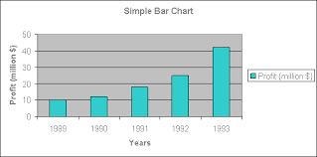
Types of bar diagram
Simple bar diagram: It represent only one variable. For example sales, production, population figures, etc.. These are same in width and varies only in heights. It becomes very easy for readers to study the data instead of the data in tabular form.

Slide 19
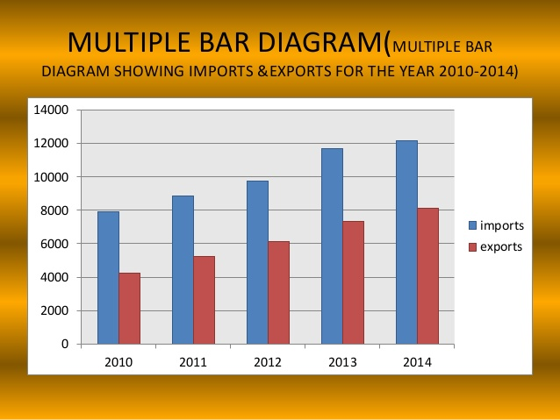
Types of bar diagram
Multiple bar diagram: This method can be used for data which is made up of two or more components.in this method the components are shown as separate adjoining bars. The components are shown by different shades and colours

Slide 20
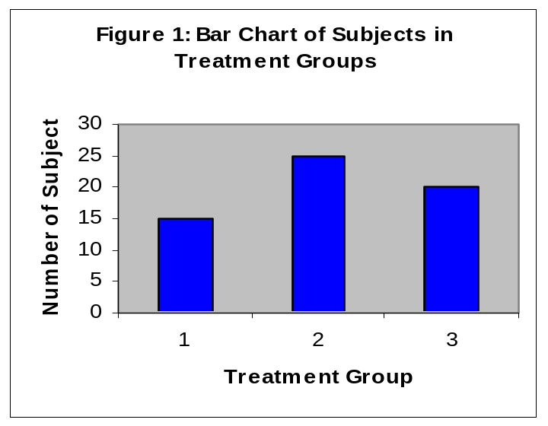
Data Presentation –Categorical Variable
Bar Diagram: Lists the categories and presents the percent or count of individuals who fall in each category.
Treatment Group | Frequency | Proportion | Percent (%)
1 | 15 | (15/60)=0.25 | 25.0
2 | 25 | (25/60)=0.333 | 41.7
3 | 20 | (20/60)=0.417 | 33.3
Total | 60 | 1.00 | 100

Slide 21
Histogram
Histogram is a representation of a frequency distribution by means of rectangles.
Width of bars represents class boundaries and height represents corresponding frequency
Histograms are the diagrams of frequency distribution for the continuous data
Histograms is similar to bar diagram but the histogram groups numbers into ranges where as bar diagram doesn’t deals with the ranges. It deals with categories

Slide 22
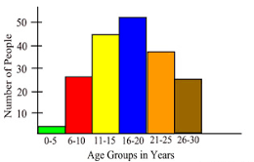
Histogram-Ages group in years
Ages Frequency
0-5 3
6-10 25
11-15 44
16-20 50
21-25 37
26-30 27

Slide 23
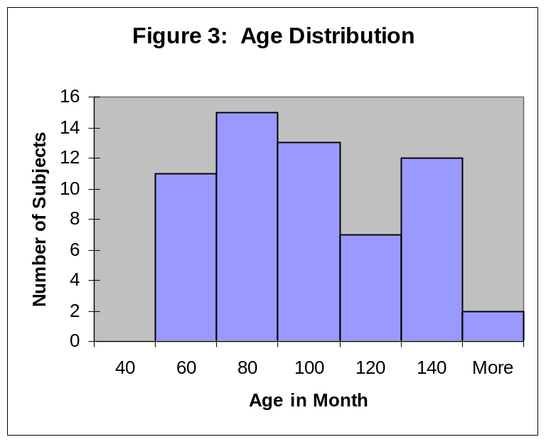
Graphical Presentation –Numerical Variable
Histogram: Overall pattern can be described by its shape, center, and spread. The following age distribution is right skewed. The center lies between 80 to 100. No outliers.
Mean | 90.41666667
Standard Error | 3.902649518
Median | 84
Mode | 84
Standard Deviation | 30.22979318
Sample Variance | 913.8403955
Kurtosis | -1.183899591
Skewness | 0.389872725
Range | 95
Minimum | 48
Maximum | 143
Sum | 5425
Count | 60

Slide 24
Pie diagram
The categories are displayed as segments of a circle whose pieces add up to 100% of the total frequencies.
The pie diagram is a commonly Used graphical device for presenting relative frequency distribution for qualitative data
Pie diagram is a circular (360 degrees) graphical representation
It is also called divided circle diagram.divided circle diagram.

Slide 25
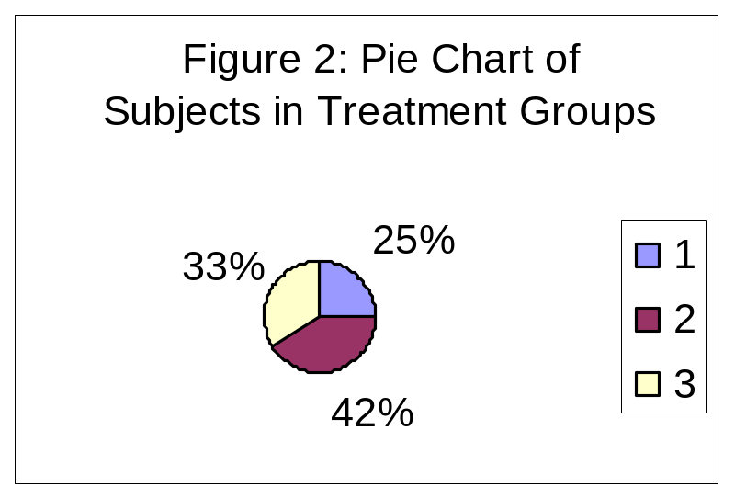
Data Presentation –Categorical Variable
Pie Chart: Lists the categories and presents the percent or count of individuals who fall in each category.
Treatment Group | Frequency | Proportion | Percent (%)
1 | 15 | (15/60)=0.25 | 25.0
2 | 25 | (25/60)=0.333 | 41.7
3 | 20 | (20/60)=0.417 | 33.3
Total | 60 | 1.00 | 100

Slide 26
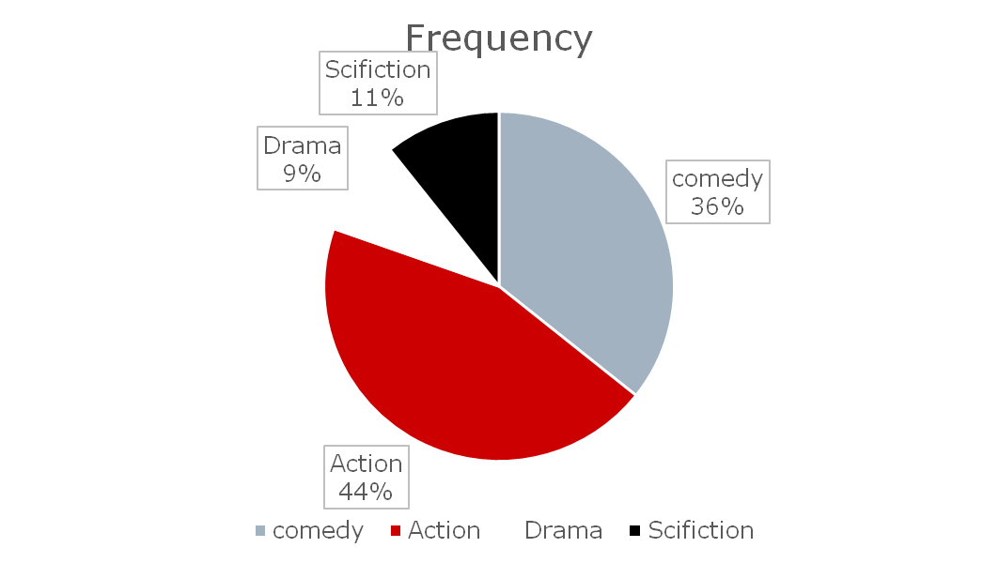
Pie diagram- favourite type of movie
Comedy Action Drama Science fiction
4 5 1 4

